Slide 1
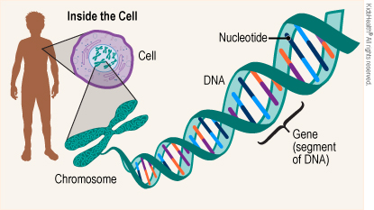
The Central Dogma

Slide 2
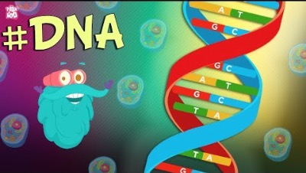
What Is DNA?

Slide 3
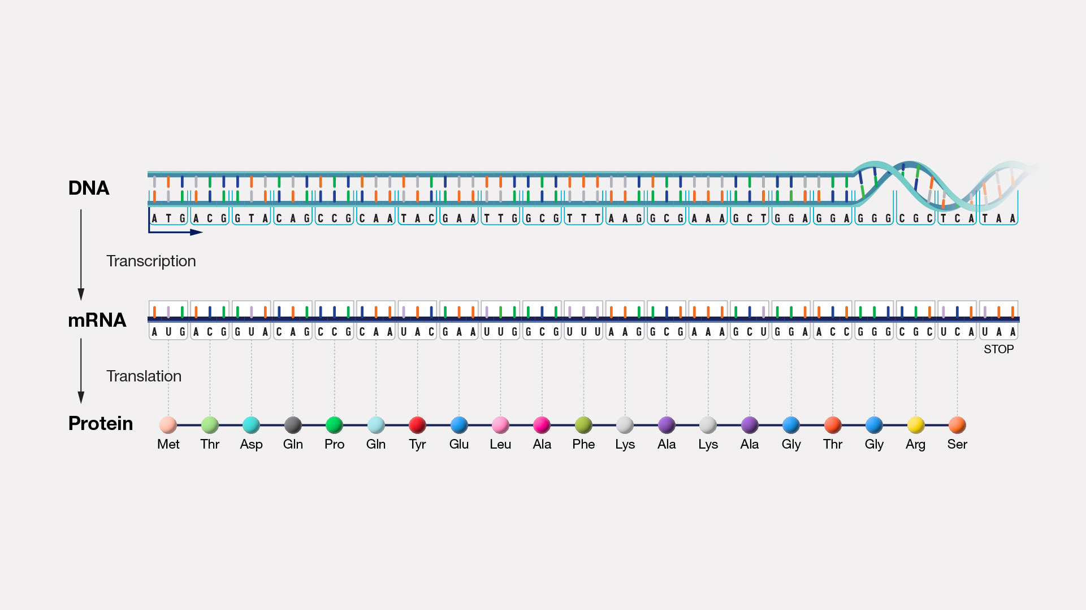
Central dogma
The central dogma of molecular biology is a theory stating that genetic information flows only in one direction, from DNA, to RNA, to protein, or RNA directly to protein.
In 1958, the fundamental theory of central dogma was developed by Francis Crick, discoverer of the structure of DNA ,

Slide 4
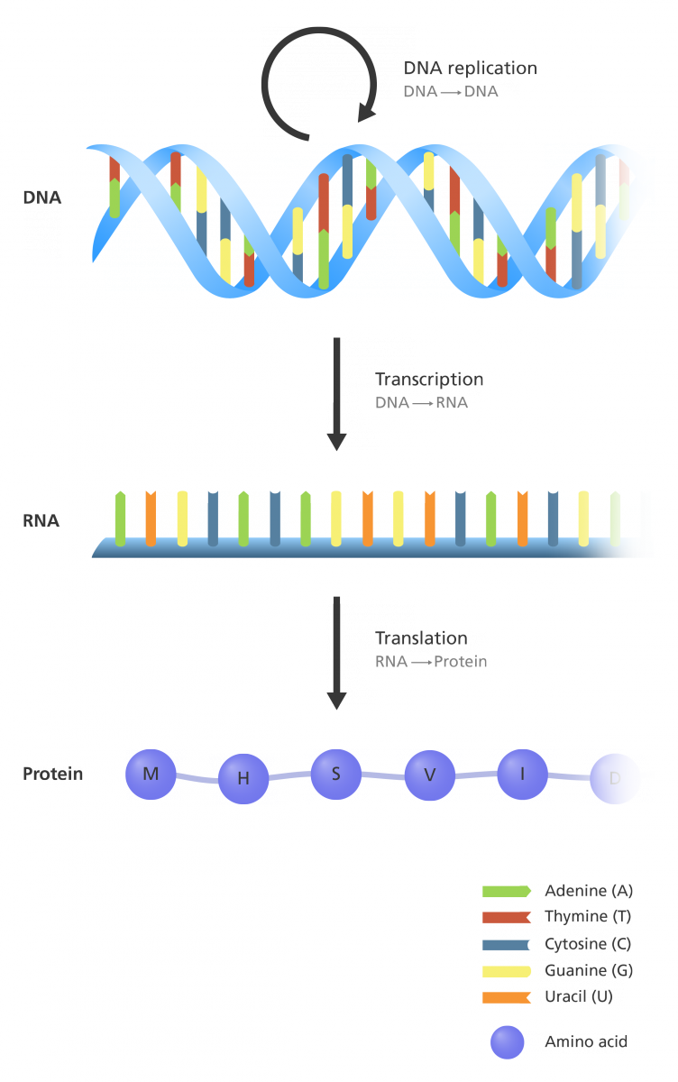
The flow of genetic information
The central dogma states that the pattern of information that occurs most frequently in our cells is:
From existing DNA to make new DNA (DNA replication)
From DNA to make new RNA (transcription)
From RNA to make new proteins (translation).

Slide 5
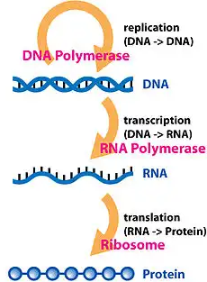
The central dogma
The central dogma of molecular biology explains the flow of genetic information, from DNA to RNA, to make a functional product, a protein.
The central dogma suggests that DNA contains the information needed to make all of our proteins, and that RNA is a messenger that carries this information to the ribosomes.
The ribosomes serve as factories in the cell where the information is ‘translated’ from a code into the functional product.
The process by which the DNA instructions are converted into the functional product is called gene expression.
Gene expression has two key stages: transcription and translation.
In transcription (RNA synthesis), the information in the DNA of every cell is converted into small, portable RNA messages.
During translation (protein synthesis), these messages travel from where the DNA is in the cell nucleus to the ribosomes where they are ‘read’ to make specific proteins.

Slide 6
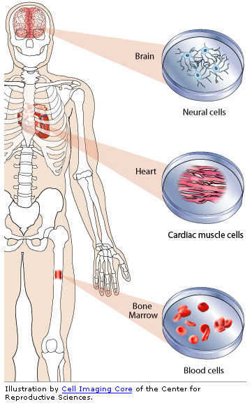
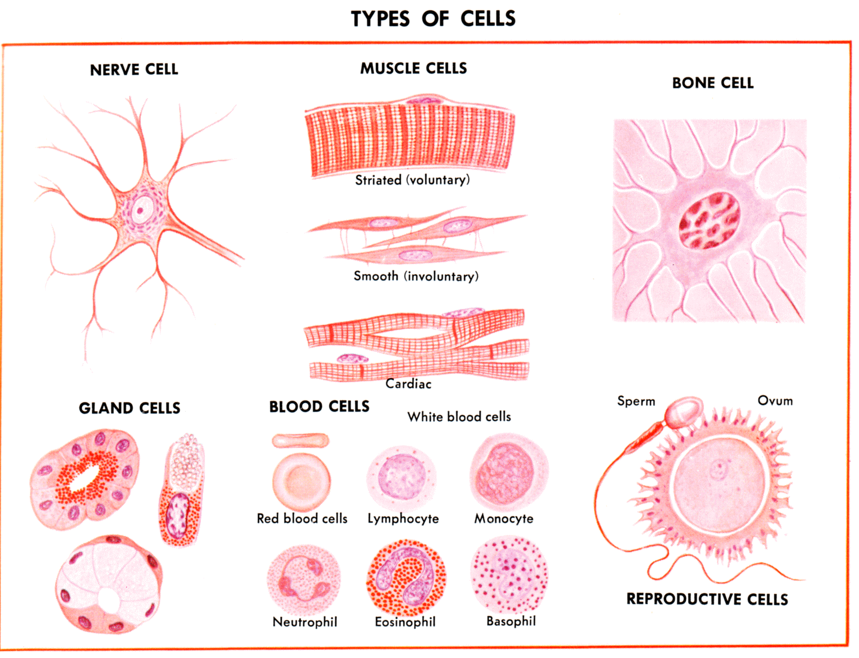
How do we have different cell types?
Because of GENE EXPRESSION

Slide 7
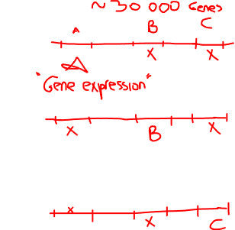

Slide 8
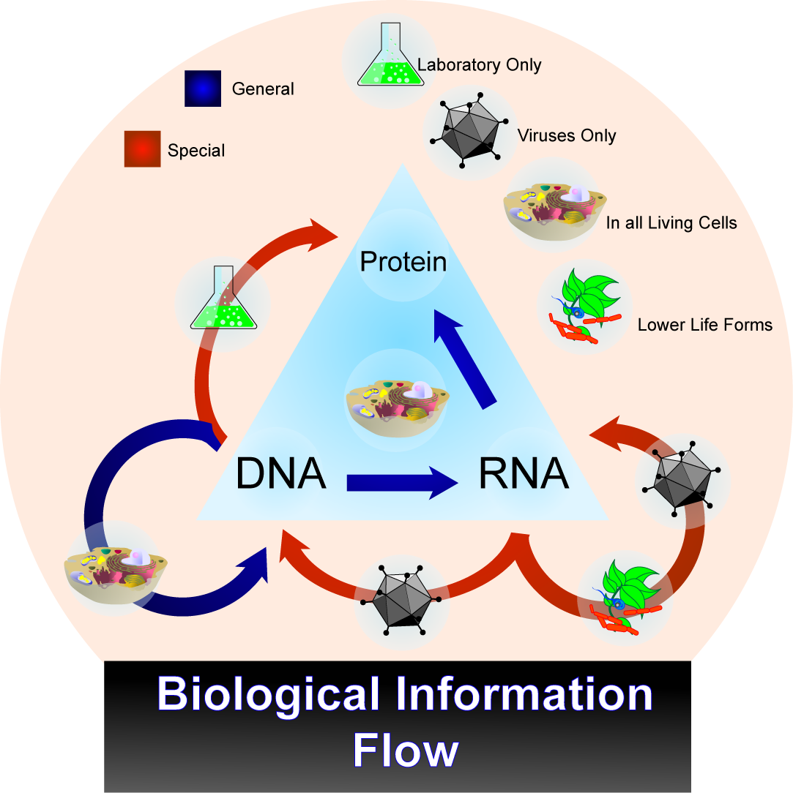
The central dogma
There are special steps for some organisms;
SARS-CoV2 virus: RNA → RNA synthesis
HIV virus : RNA → DNA synthesis

Slide 9
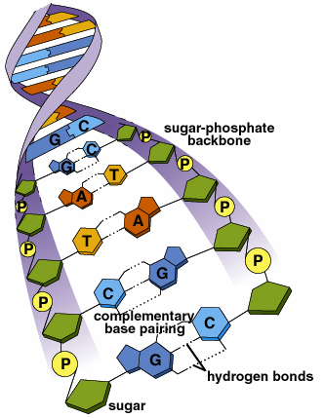
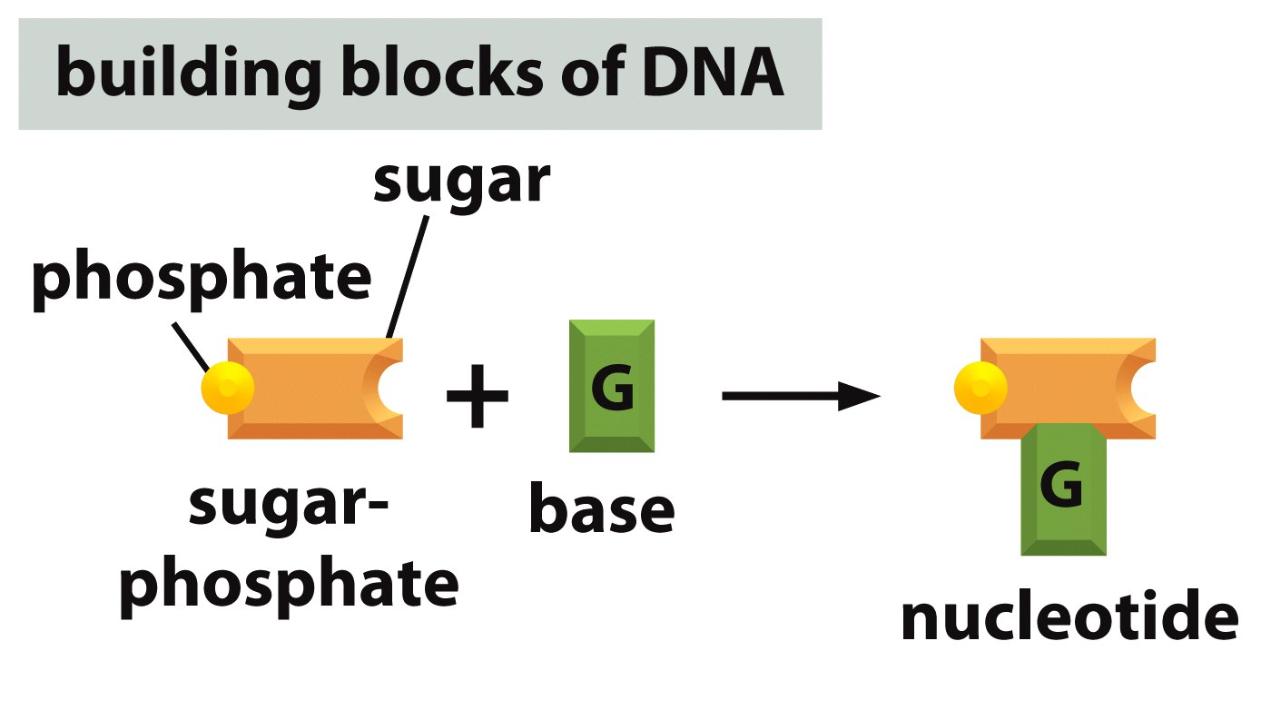
What is DNA?
3’
5’
DNA or deoxyribonucleic acid is a long molecule that contains our unique genetic code. Like a recipe book it holds the instructions for making all the proteins and RNAs in our cells.
DNA contains four basic building blocks or ‘bases’: adenine (A), cytosine (C), guanine (G) and thymine (T).
DNA is a two-stranded molecule. DNA has a unique ‘double helix’ shape, like a twisted ladder.
The bases on one strand of the DNA molecule pair together with complementary bases on the opposite strand of DNA.
The bases always pair together in the same way, A with T, and C with G.
Each base pair is joined together by hydrogen bonds.
Each strand of DNA has a beginning and an end, called 5’ (five prime) and 3’ (three prime) respectively. The two strands run in the opposite direction (antiparallel) to each other
This double helix structure was first discovered by Francis Crick and James Watson with the help of Rosalind Franklin and Maurice Wilkins.
3’
5’

Slide 10
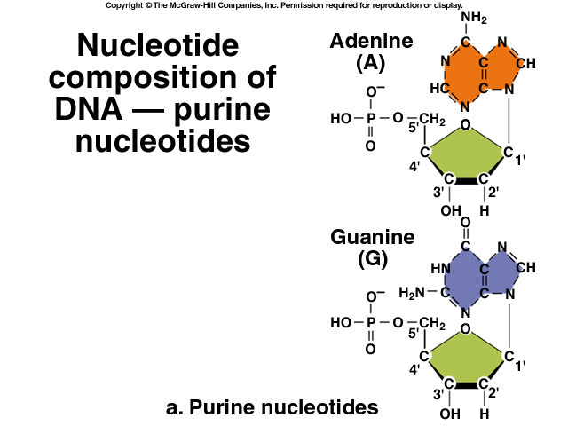
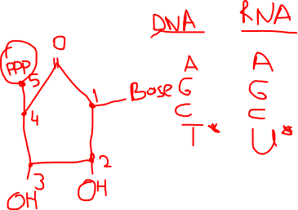

Slide 11
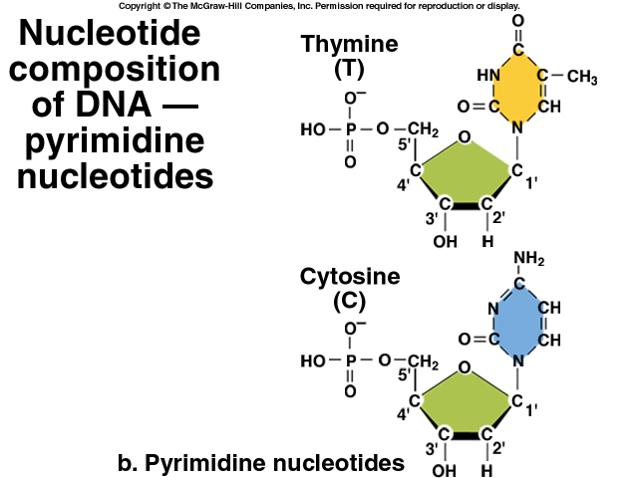

Slide 12
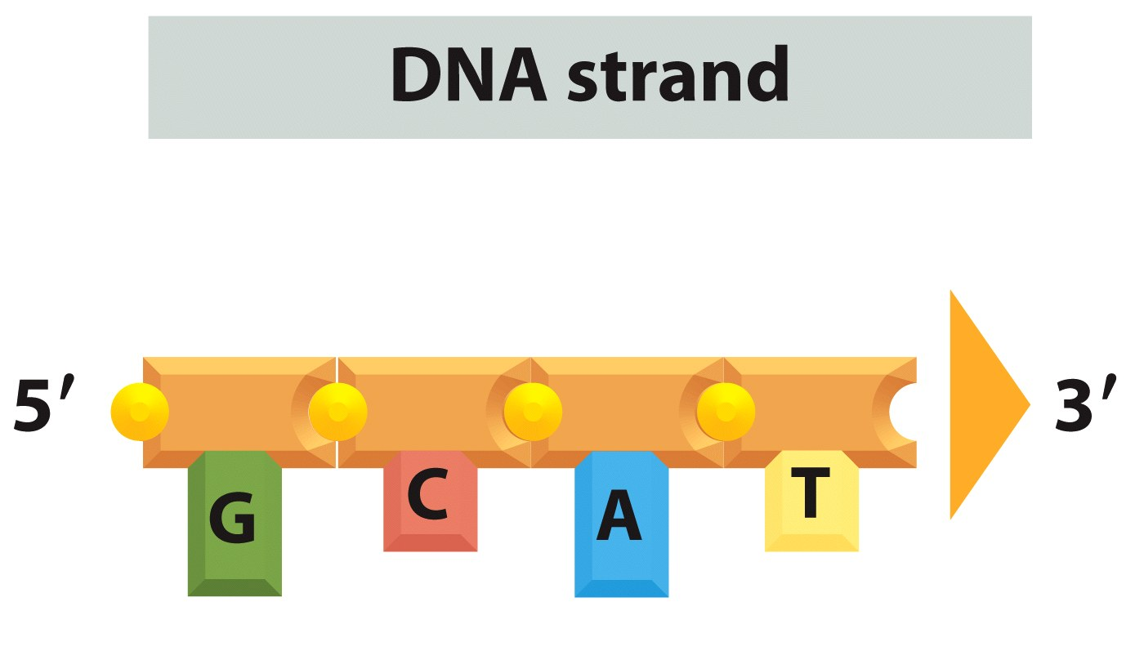

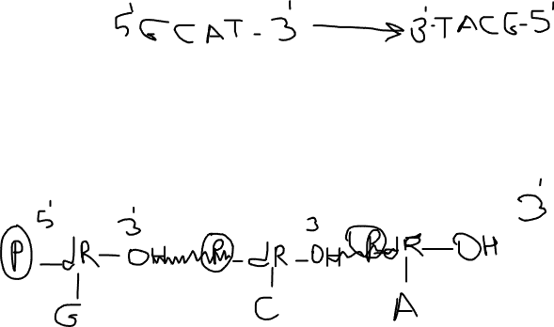
Figure 5-2b Essential Cell Biology (© Garland Science 2010)

Slide 13
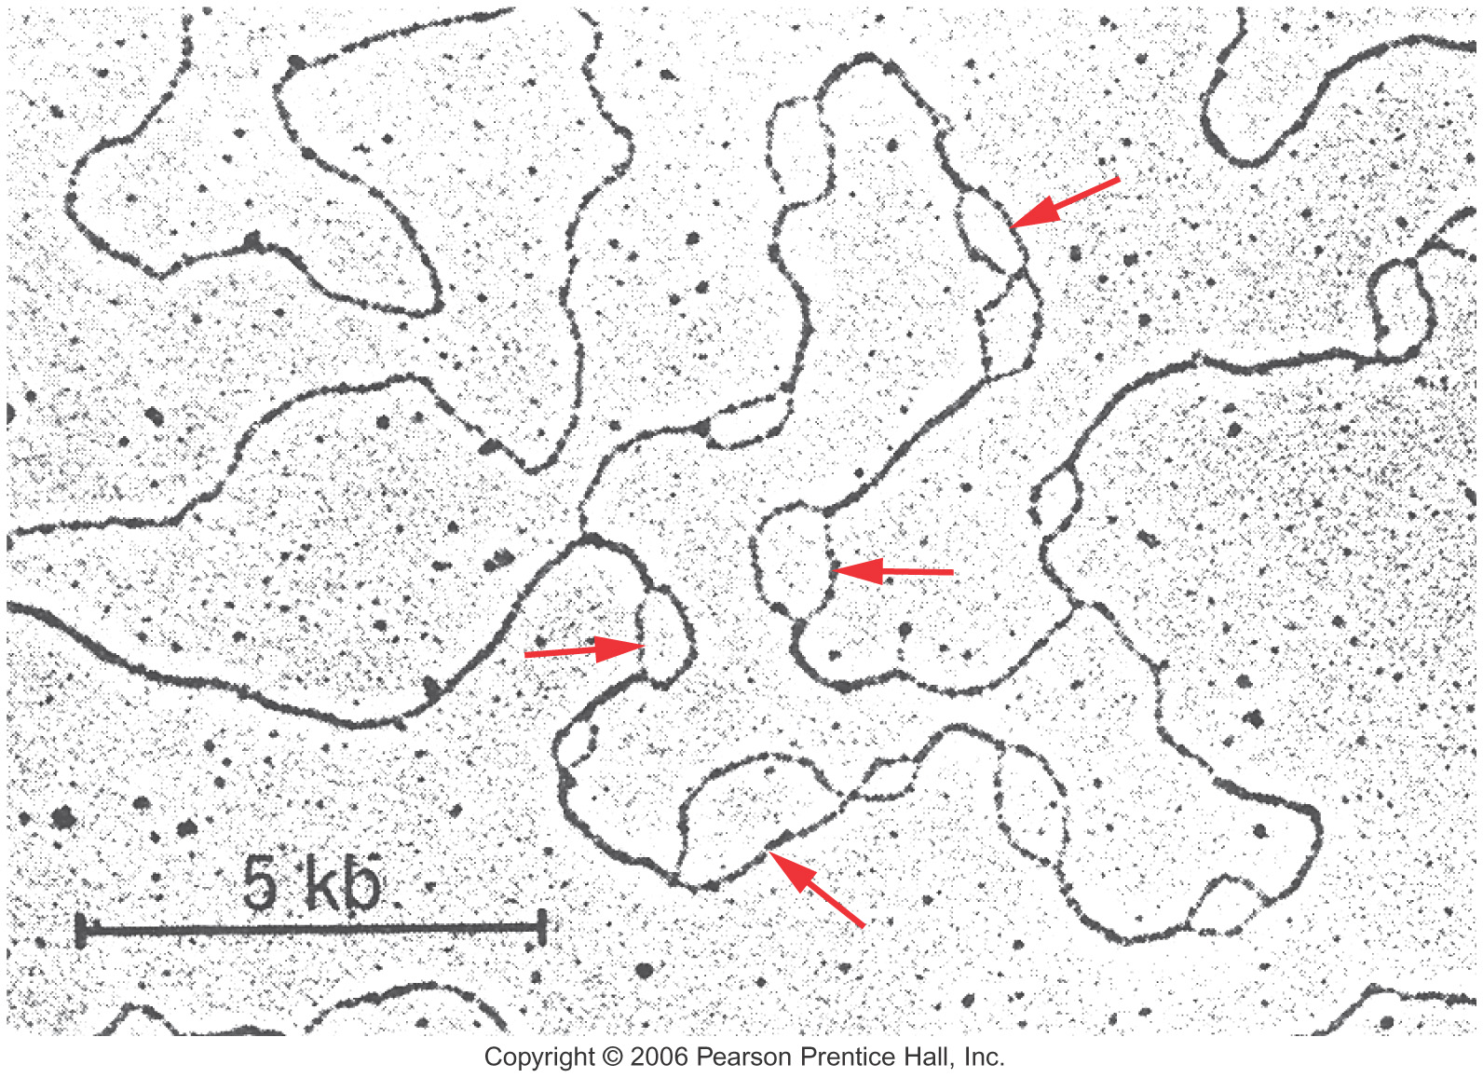
DNA is 2m long (2 000 000μm)
Diameter of nucleus 5-10μm
Copyright © 2006 Pearson Prentice Hall, Inc.

Slide 14
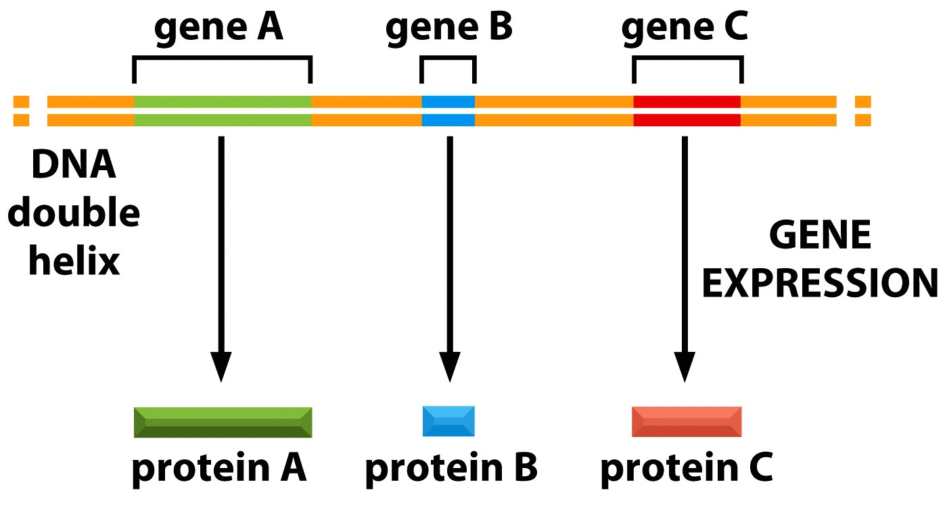
Genes are dispersed throughout the chromosome
Figure 5-13 Essential Cell Biology (© Garland Science 2010)

Slide 15
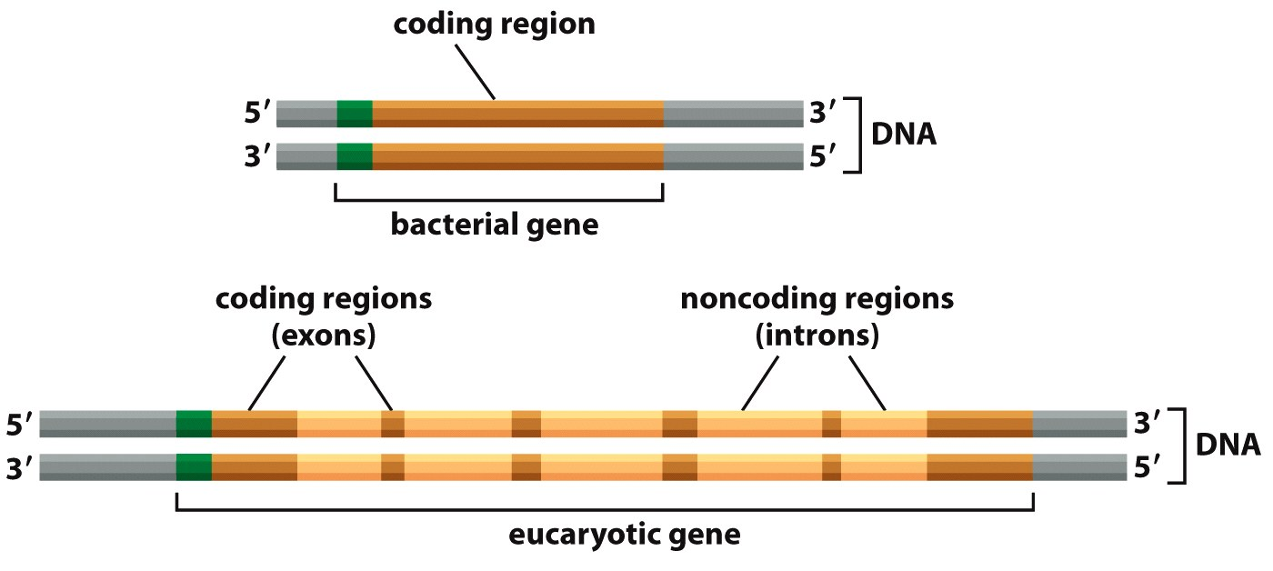
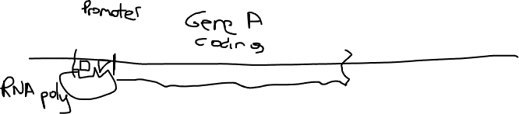
The structure of a Gene
Gene= Regulatory region (promoter) + coding region
Noninterrupted gene
Interrupted gene
Figure 7-17 Essential Cell Biology (© Garland Science 2010)

Slide 16
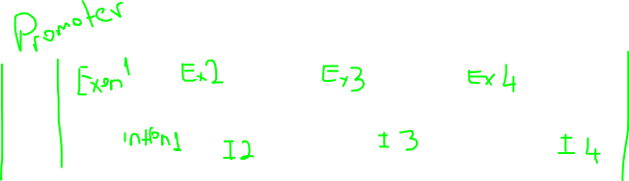
abdshgTHISxyelokmnbISnnnbawplsBIOLOGYvvbxzpuytrCOURSEaaassssbbbbb
xxxxxabdshgTHISISBIOLOGYCOURSExxxxx

Slide 17
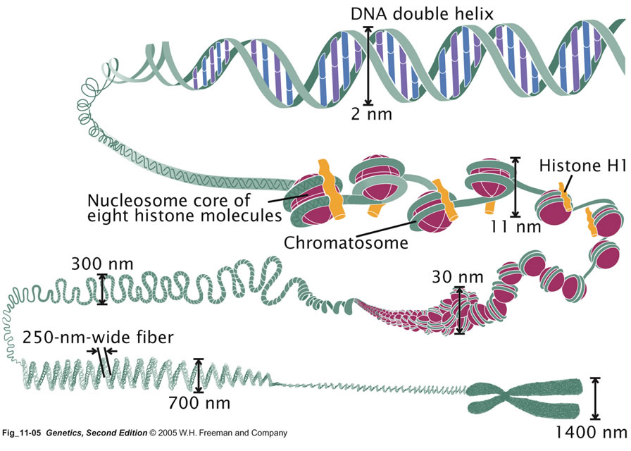
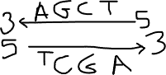
Structure of DNA
DNA (deoxyribonucleic acid) is the cell’s genetic material
DNAs are coiled up into structures called chromosomes.
Your chromosomes are located within the cell nucleus (chr1-22,X,Y) and mitochondria (mitochondrial chromosome).
Except for certain cells (for example, sperm and egg cells and red blood cells), the cell nucleus contains 23 pairs of chromosomes.
A chromosome contains many genes. A gene is a segment of DNA that provides the code to construct a protein.

Slide 18
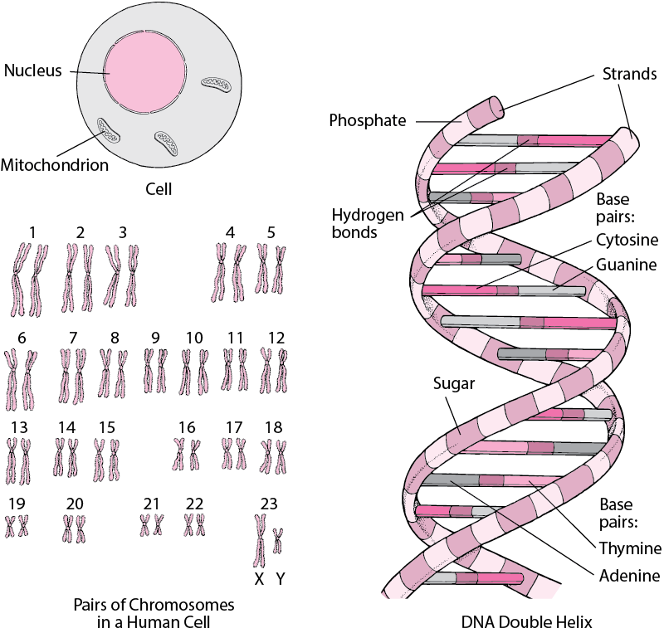
Structure of DNA
DNA (deoxyribonucleic acid) is the cell’s genetic material
DNAs are coiled up into structures called chromosomes.
Your chromosomes are located within the cell nucleus (chr1-22,X,Y) and mitochondria (mitochondrial chromosome).
Except for certain cells (for example, sperm and egg cells and red blood cells), the cell nucleus contains 23 pairs of chromosomes.
A chromosome contains many genes. A gene is a segment of DNA that provides the code to construct a protein.

Slide 19
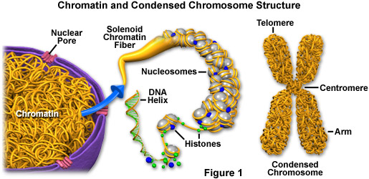
Chromosomes
Chromosomes (chromatin form) are not visible in the cell’s nucleus—not even under a microscope—when the cell is not dividing. However, the chromosomes (mitotic chromosome form) becomes more tightly packed during cell division and is then visible under a microscope. Most of what researchers know about chromosomes was learned by observing mitotic chromosomes during cell division.

Slide 20
Chromosomes (Human Karyotype)
Human chromosomes are not naked! There are histone proteins.
Histones are needed to have condensed structure
Histones are needed to regulate gene expression

Slide 21
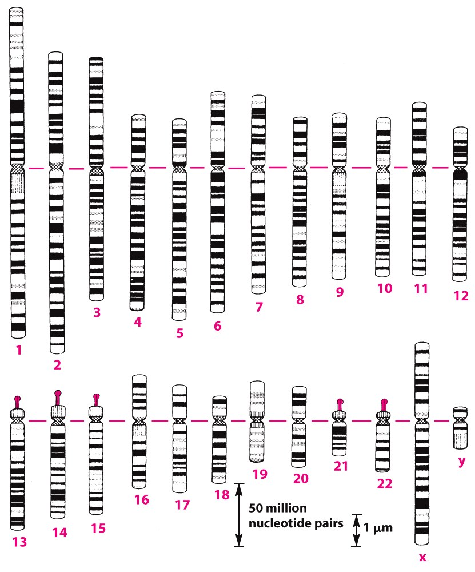
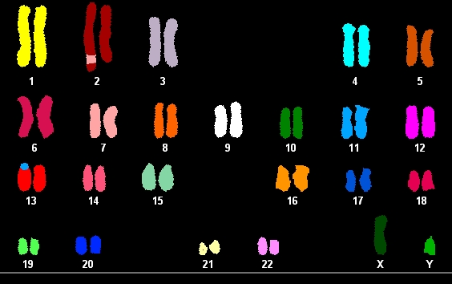
Chromosomes (Human Karyotype)
Giemsa staining Flourescent staining
Different techniquues are used to visualize the chromosomes.

Slide 22
Human chromosome karyotyping
1842
Chromosomes were first observed in plant cells by Carl Wilhelm von Nägeli in 1842.
1912
In 1912, Hans von Winiwarter reported 47 chromosomes in spermatogonia and 48 in oogonia, concluding an XX/XO sex determination mechanism
1922
Painter in 1922 was not certain whether the diploid of humans was 46 or 48, at first favoring 46, but revised his opinion from 46 to 48, and he correctly insisted on humans having an XX/XY system
1955
The work took place in 1955, and was published in 1956. The humans includes only 46 chromosomes

Slide 23
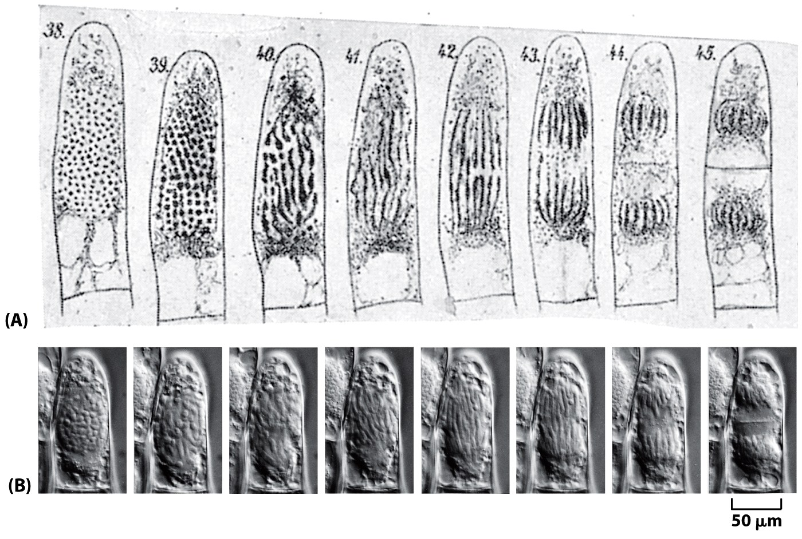
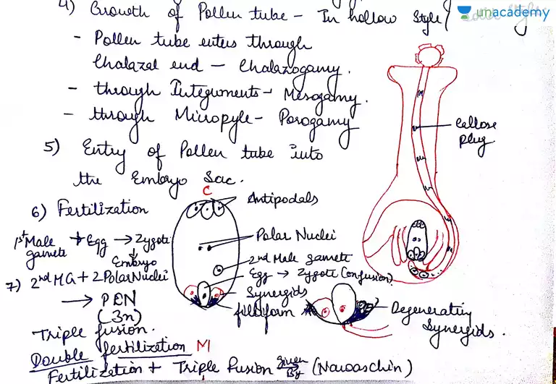
Eduard Strasburger, 1880 first documented cell division

Slide 24
Human chromosome karyotyping
1842
Chromosomes were first observed in plant cells by Carl Wilhelm von Nägeli in 1842.
1912
In 1912, Hans von Winiwarter reported 47 chromosomes in spermatogonia and 48 in oogonia, concluding an XX/XO sex determination mechanism
1922
Painter in 1922 was not certain whether the diploid of humans was 46 or 48, at first favoring 46, but revised his opinion from 46 to 48, and he correctly insisted on humans having an XX/XY system
1955
The work took place in 1955, and was published in 1956. The humans includes only 46 chromosomes

Slide 25
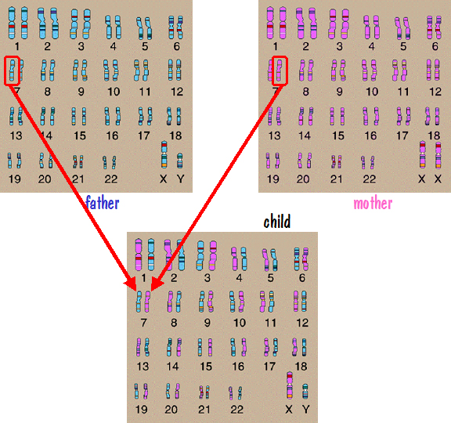
Inheritance of chromosomes
Chromosomes come in pairs.
Normally, each cell in the human body has 23 pairs of chromosomes (46 total chromosomes).
Half come from the mother; the other half come from the father.

Slide 26

Karen Keegan
Karen Keegan from Boston, MA, USA, was hoping that one of her three sons might be a match for a kidney transplant, after her first transplant failed.
Initial tests indicated that the three men are brothers, but that two of them are not her sons. “At the time, the referring nephrologist reported that she had excluded Keegan as the mother of two of her kids, and how could that be? We thought there was a problem with testing; that there was a mistake. So we had her retested and examined and sure enough it showed the same thing,” said Lynne Uhl, a transfusion medicine specialist at Beth Israel Deaconess Medical Center in Boston, who was part of the team that discovered Keegan's chimerism. “We knew this woman very well and knew without any doubt that she was the mother of these kids.
The doctors began examining other tissues, including hair follicles and cheek swabs, and recovered stored tissue samples from several earlier minor surgical procedures. They found that some of her tissues confirmed her sons and brothers.

Slide 27
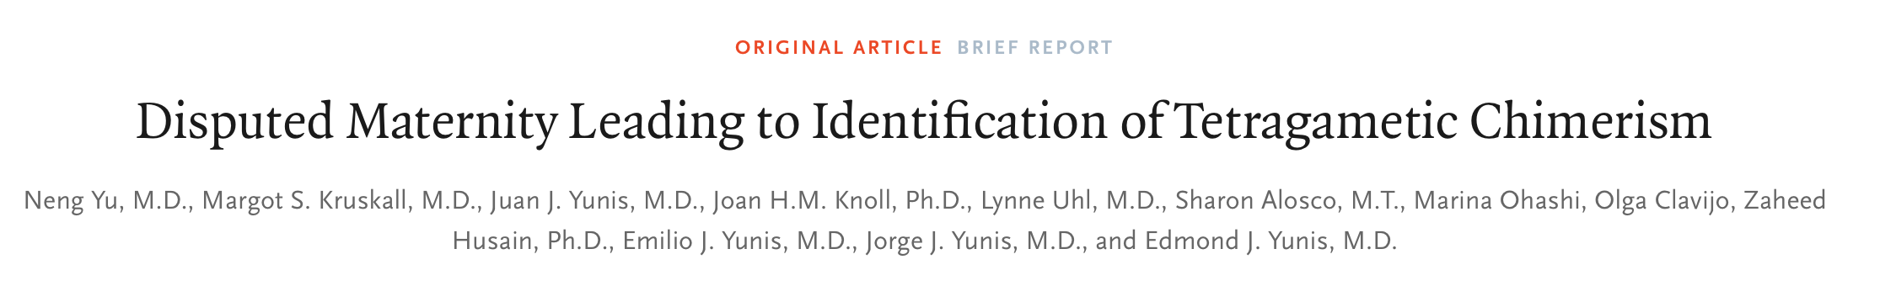

Karen Keegan

Slide 28
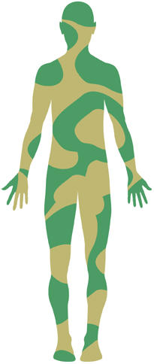
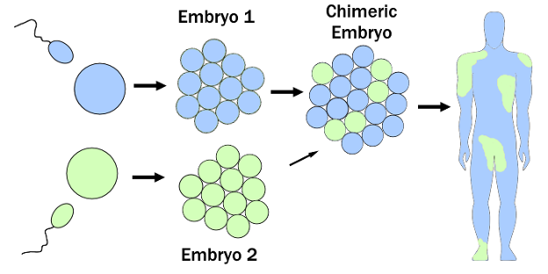
Chimerism
Ancient Greek mythology includes stories of a fire-breathing creature called a chimera. This fearsome beast was a mix between a lion, goat, and serpent.
A chimeric human, or human chimera, has two or more populations of genetically different cells that originated from different zygotes.
Frequently chimerism occurs spontaneously during embryogenesis. Twins fuse to get single body.
There 2 sets of cells with different chromosomes. The fusion of two person!
Chimerism is not rare, but rarely discovered, because it seldom generates any observable anomalies.

Slide 29

Lydia Fairchild
In December 2002, as the couple went their separate ways, Lydia applied for financial assistance to help take care of her young children.
In order to apply for government assistance in Washington State at the time, both Lydia and Jamie had to be tested to prove their relation to their children.
The DNA result showed that 'He's 99 per cent the father... but there's a problem, there's no way that you're the mother,’”
Lydia was not only denied financial assistance for her children, but she was now the subject of a criminal investigation.
Lawyers in a welfare fraud case in Washington heard about the Keegan case and invited the Boston researchers to check out Lydia Fairchild. The Boston team showed that Fairchild was in fact the mother—all her children came from a second line of chimeric cells.

Slide 30

Taylor Muhl
Taylor Muhl is an American singer-songwriter, model, dancer, and awareness advocate.
When Taylor Muhl was born, her mother was told that her baby’s two-toned skin was a birthmark.
Now at 33 years old, Muhl, a musician and model, understands her two-toned skin is actually a result of chimerism. She fused with her twin.

Slide 31

Abby and Brittany Hensel

Slide 32

Conjoined Sisters Celebrate 10 Years Apart

Slide 33
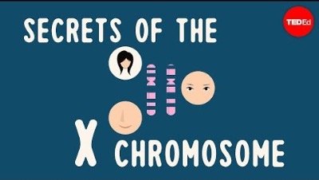
Secrets of the X chromosome

Slide 34
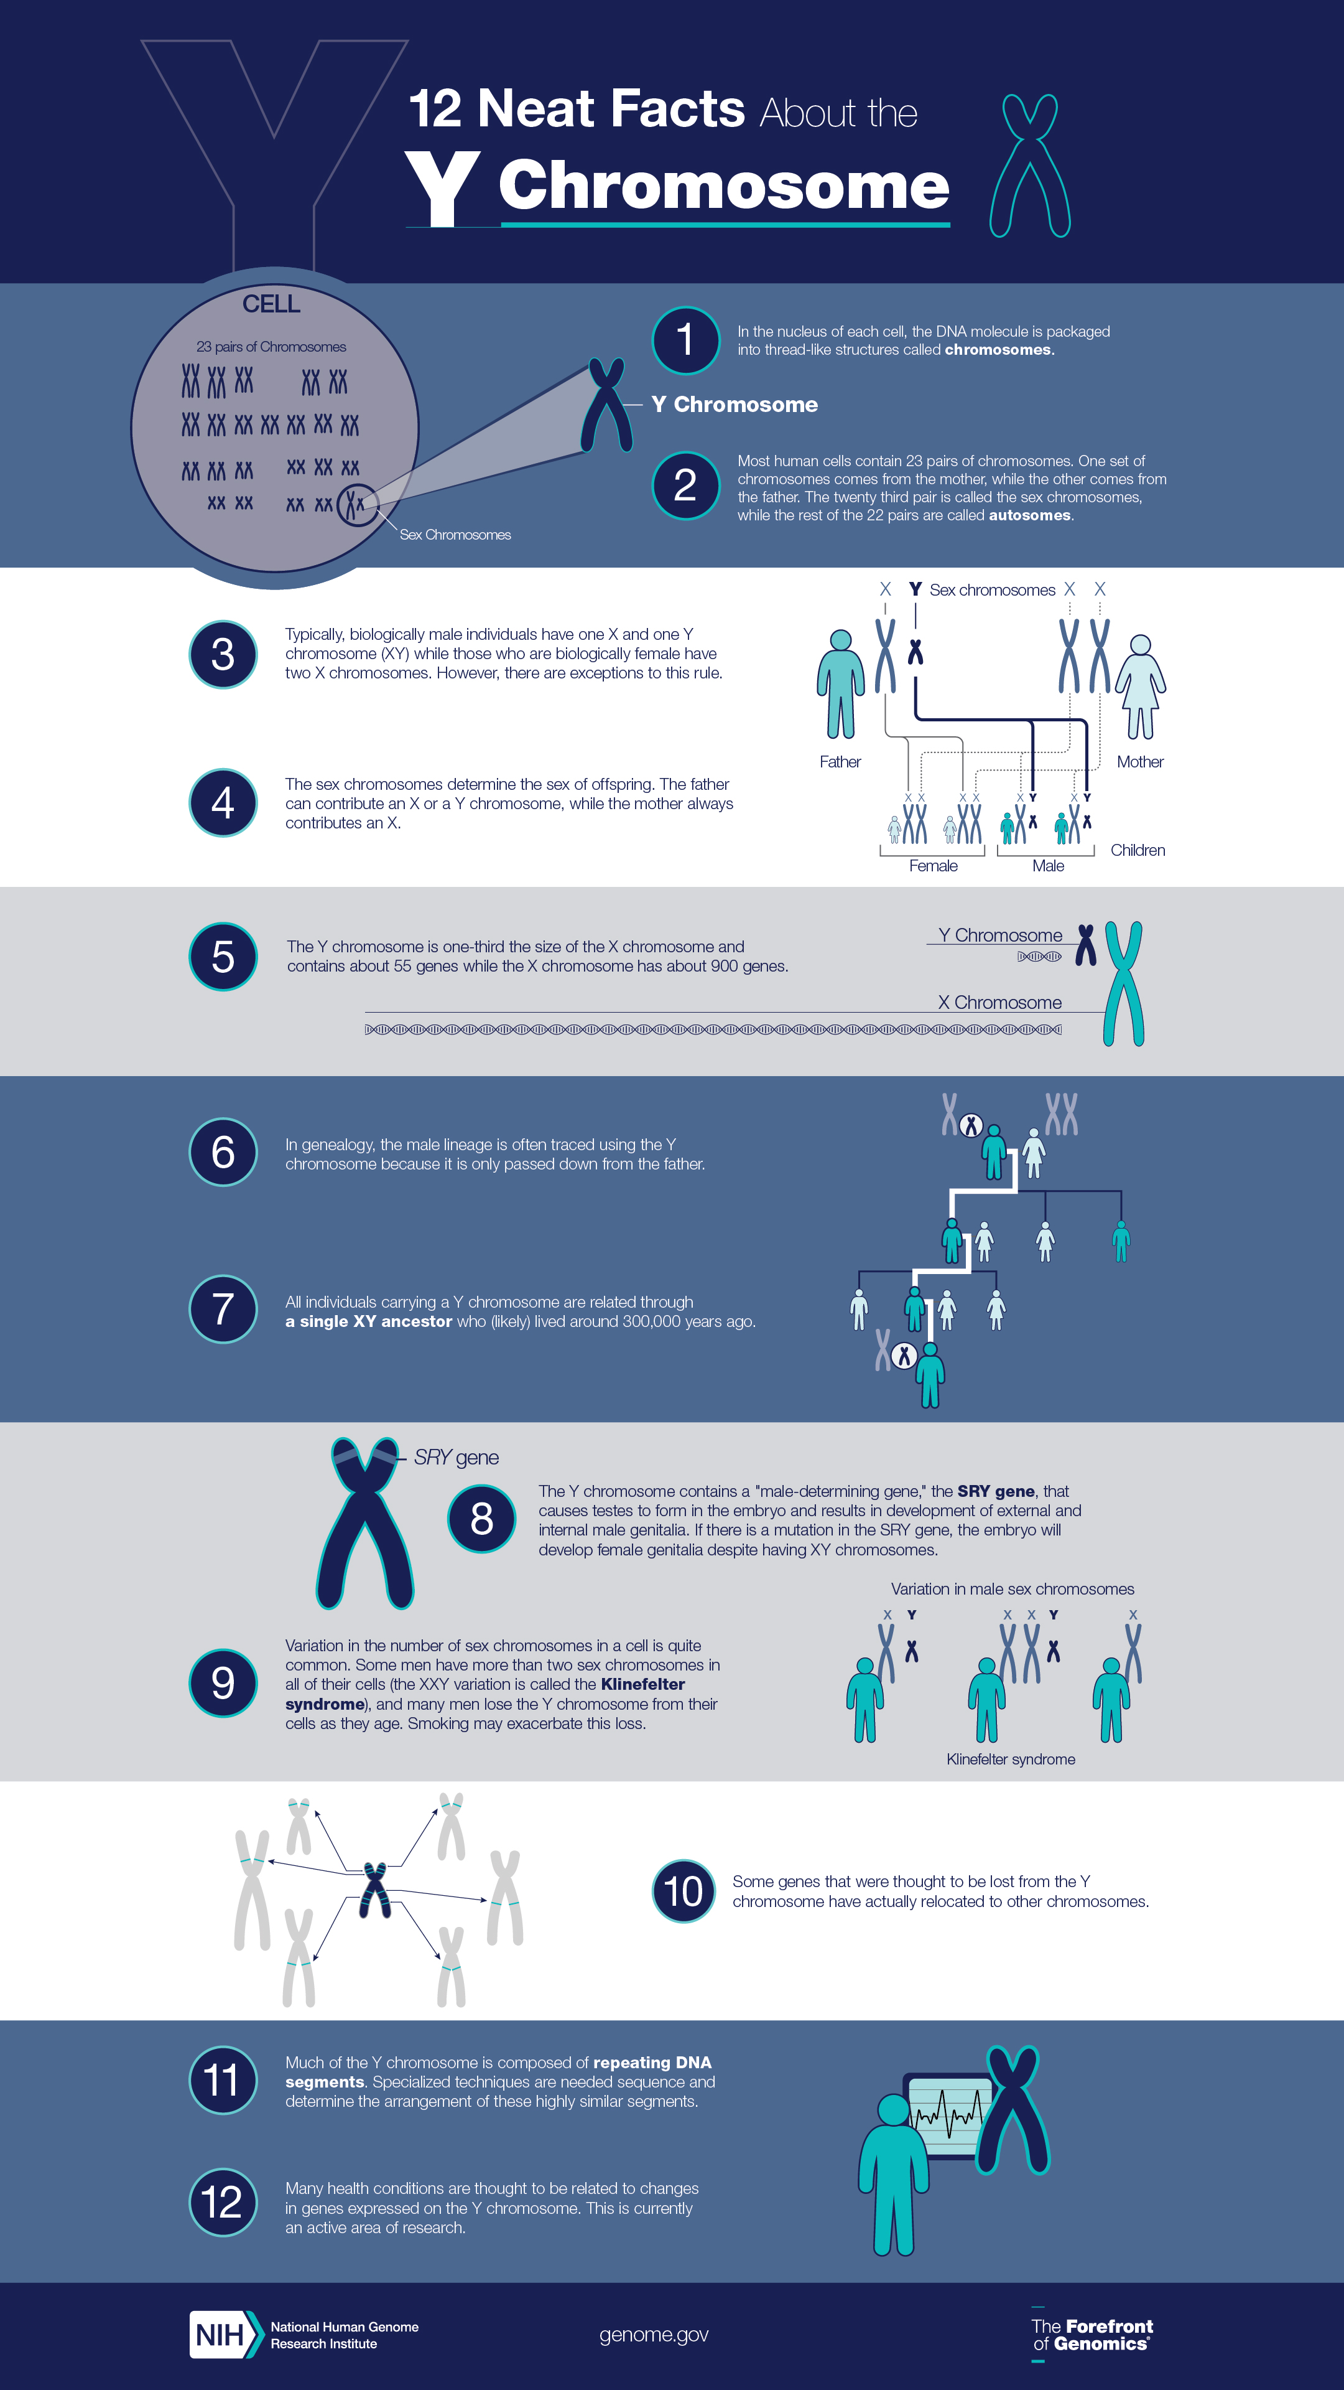
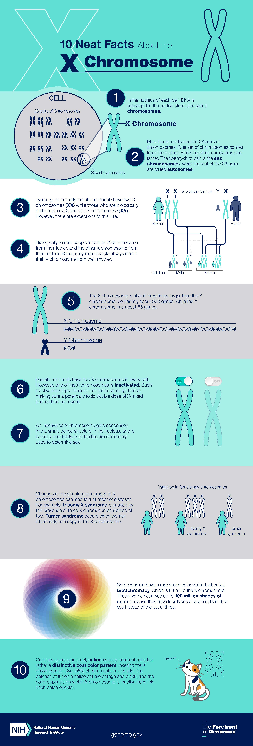

Slide 35
Inheritance of chromosomes
Chromosomes come in pairs.
Normally, each cell in the human body has 23 pairs of chromosomes (46 total chromosomes).
Half come from the mother; the other half come from the father.

Slide 36
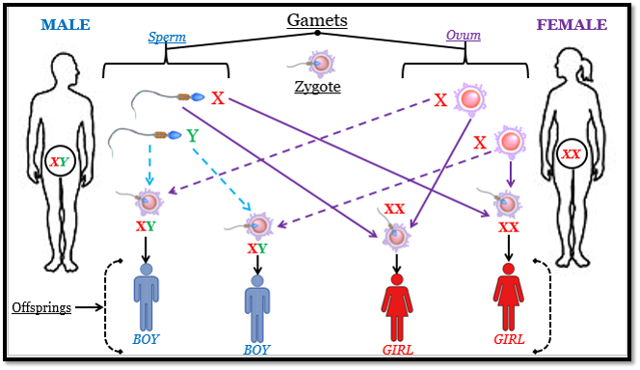
Human Gender
X and Y chromosomes determine the genders.
Female: XX
Male : XY

Slide 37
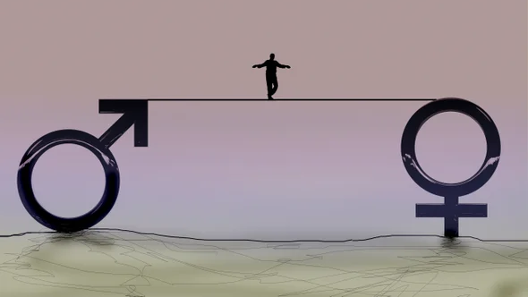
Human Gender
Binary Gender (traditional genders: Male and Female)
There are more than two genders, even though in our society the genders that are most recognized are male and female (called the gender binary) and usually is based on someone’s anatomy (the genitals they were born with). This is gender assignment and it is based on an assumption that someone’s genitals match their gender.
Gender is a complex thing. It depends on various factors, such as sex chromosomes, reproductive organs, hormones, secondary sex characteristics, and related medical care.
Genders can be controversial … How genders should be classified?
Depend on the genital anatomy (The penis (males) and clitoris (females))?
Depend on the physical appearance?
Depend on the Chromosomes (XX, XY, XXY)?
Depends on the emotions?

Slide 38
Disorders of sex development (DSD)
A 46-year-old pregnant woman had visited his clinic at the Royal Melbourne Hospital in Australia to hear the results of an amniocentesis test to screen her baby's chromosomes for abnormalities. The baby was fine—but follow-up tests had revealed something astonishing about the mother. Her body was built of cells from two individuals, probably from twin embryos that had merged in her own mother's womb. And there was more. One set of cells carried two X chromosomes, the complement that typically makes a person female; the other had an X and a Y. Halfway through her fifth decade and pregnant with her third child, the woman learned for the first time that a large part of her body was chromosomally male.
This is an example of disorders of sex development (DSDs). A disease affecting the sex development and sex characteristics due to the chromosome abnormalities or gene mutations.
DSD is common as many as 1 person in 100 to 1 in 1000 people.
(for example, the prevalence of XY females is 6.4 per 100,000 live born females.)
More information:
https://en.wikipedia.org/wiki/Disorders_of_sex_development
https://www.ncbi.nlm.nih.gov/pmc/articles/PMC5866176/

Slide 39
Chromosomes (Human Karyotype)
Giemsa staining Flourescent staining
Different techniquues are used to visualize the chromosomes.

Slide 40
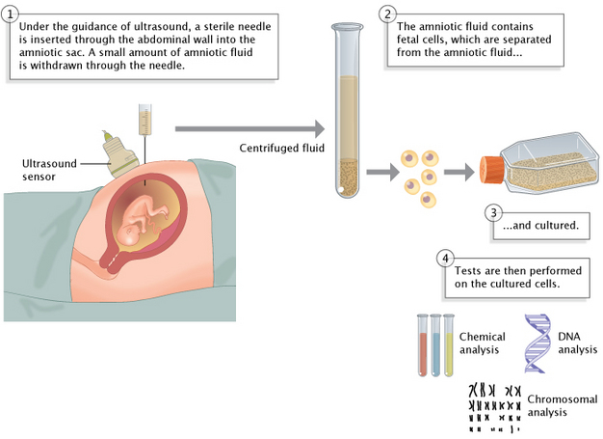
Prenatal Screen Detects Fetus Abnormalities during pregnancy
An estimated 240 000 newborns die worldwide within 28 days of birth every year due to birth defects. Birth defects cause a further 170 000 deaths of children between the ages of 1 month and 5 years.
Nine of ten children born with a serious birth defect are in low- and middle-income countries.
The most common severe birth defects are heart defects, neural tube defects and Down syndrome.
They can be detected by ultrasound imaging and genetic analysis
Genetic abnormalities i.e. chromosomal abnormalities (for example Down syndrome or trisomy 21) or single gene defects (for rxample SMA, beta thalassemia, Cystic Fibrosis etc.)

Slide 41
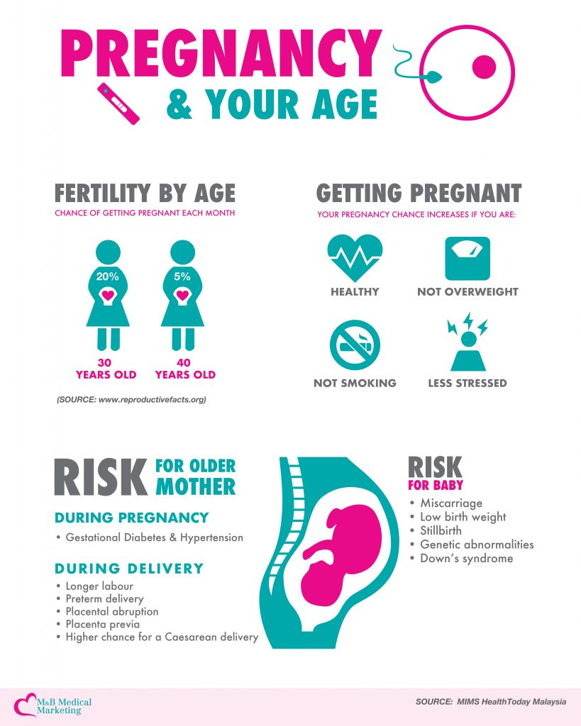
Pregnancy after 35: Healthy pregnancies, healthy babies
After age 35, there's a higher risk of pregnancy-related complications.
The risk of pregnancy loss is higher.
The risk of gestational diabetes increases. This type of diabetes occurs only during pregnancy. It's more common in older age.
The risk of developing high blood pressure during pregnancy is higher.
There's a greater risk of premature birth and having a baby with a low birth weight.
The risk of chromosomal conditions is higher. Babies born to older mothers have a higher risk of certain chromosomal conditions, such as Down syndrome.

Slide 42
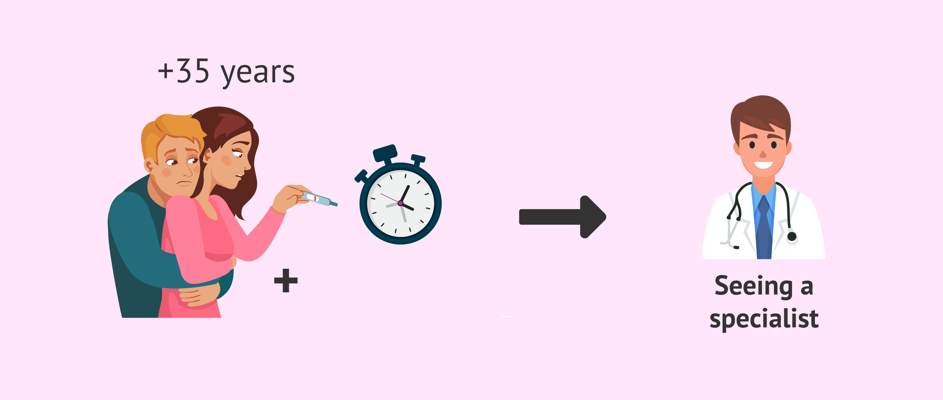
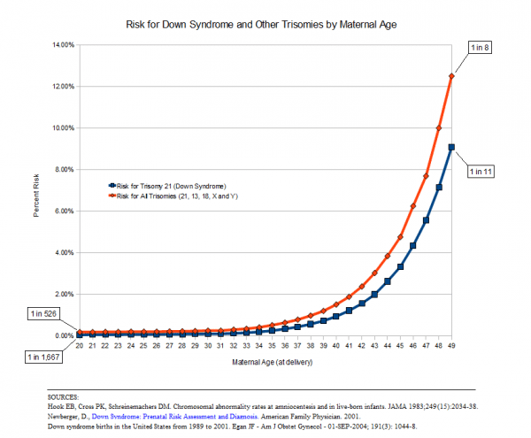

Down syndrome
Occurrence rate: 1 in every 700 births
The most common type of chromosomal abnormality, Down syndrome, also called Trisomy 21, occurs when there is an extra copy of chromosome 21. The extra chromosome can cause physical deformities, developmental defects, and mental retardation.
In order to prevent abnormal birth, the government pays the cost of genetic analysis!

Slide 43
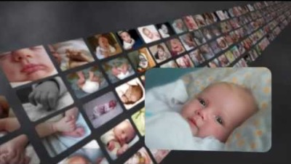
What a person can do is more important than what they can’t do

Slide 44

What is a gene?

Slide 45
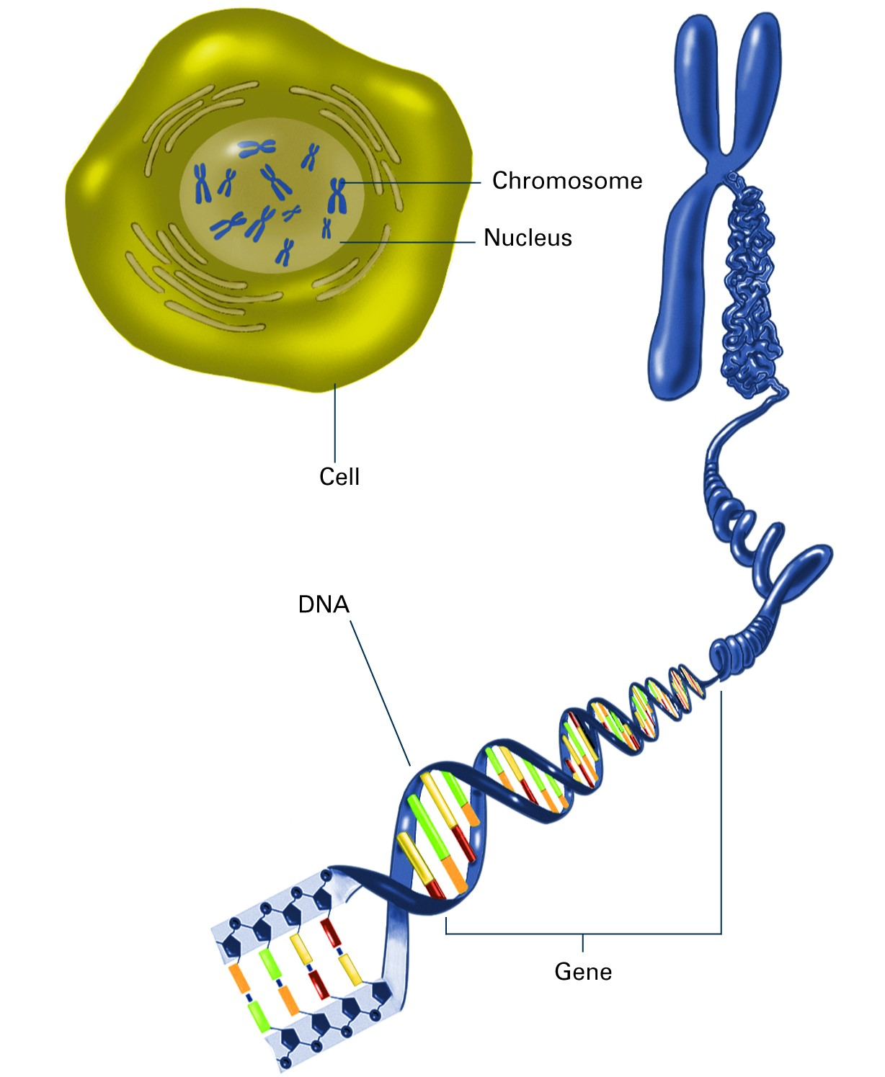
What is a gene?
Genes are small sections of DNA that code for proteins. They contain the instructions for all cellular activities and our individual characteristics – like eye and hair colour.
A genome is an organism’s complete set of genetic instructions (all informations on the DNA). Each genome contains all of the information needed to build that organism and allow it to grow and develop.

Slide 46
Gene structure
In humans, genes vary in size from a few hundred DNA bases to more than 2 million bases
Human Genome Project, which worked to determine the sequence of the human genome and identify the genes that it contains, estimated that humans have around 25,000 genes.
In human;
There are 3.2 billion nucleotides in genome
Only %2 of DNA codes GENEs, the rest part is JUNK (noncoding)
Noncoding DNA does not provide instructions for making proteins. Scientists once thought noncoding DNA was “junk,” with no known purpose.
Genes are dispersed throughout the chromosome

Slide 47
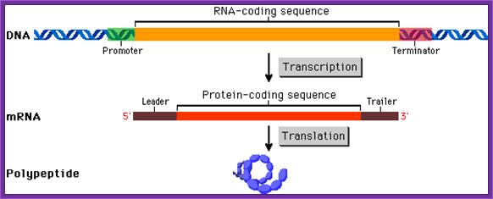
Gene structure
Each gene has two parts; Promoter and coding region.
A promoter is a region of DNA upstream of a gene where relevant proteins (such as RNA polymerase and transcription factors) bind to initiate transcription of that gene. The resulting transcription produces an RNA molecule (such as mRNA). Promoter regulates whether a gene will be expressed or how much will be expressed.
A coding region is a part of gene which is transcribed as RNA.
abcdfsfrgdmnbpromoterTHISISCODINGREGIONpklhgfdtsabmnk

Slide 48
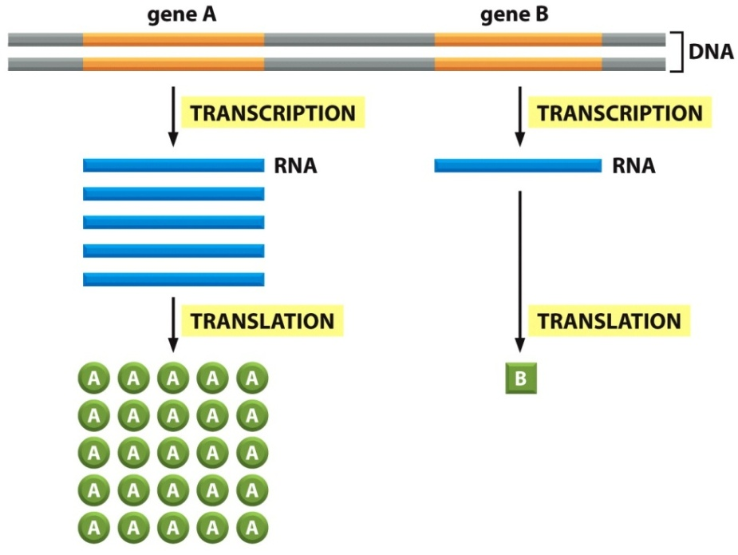
From DNA to protein (transcription and translation)
The process by which the DNA instructions are converted into the functional product is called gene expression.
Gene expression has two key stages: transcription and translation.
In transcription (RNA synthesis), the information in the DNA of every cell is converted into small, portable RNA messages.
During translation (protein synthesis), these messages travel from the cell nucleus to the ribosomes where they are ‘read’ to make specific proteins.

Slide 49
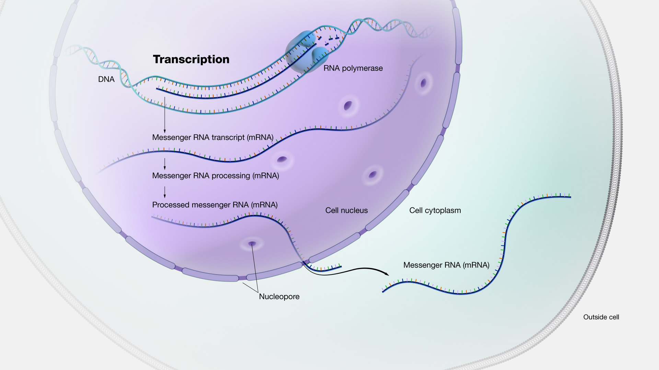
Transcription
Transcription is the process of making an RNA copy of a gene’s DNA sequence.
This copy, called messenger RNA (mRNA), carries the gene’s protein information encoded in DNA.
In eukaryotes, mRNA moves from the cell nucleus to the cell cytoplasm where ribosomes are present

Slide 50
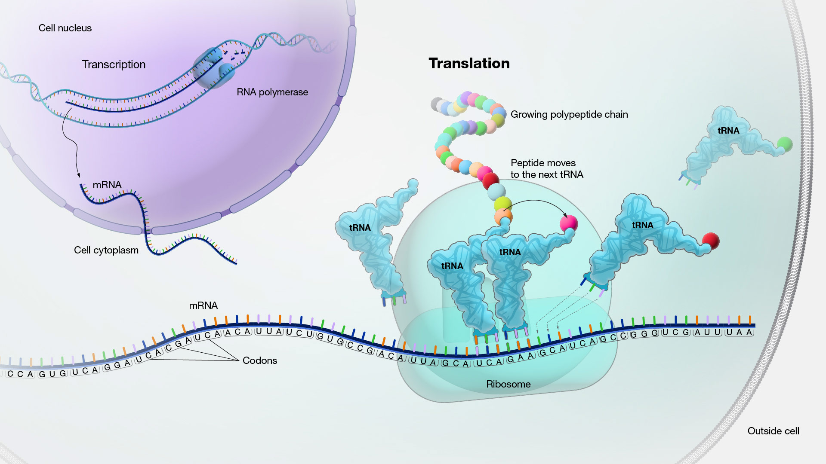
Translation
Translation is the process through which information encoded in messenger RNA (mRNA) directs the addition of amino acids during protein synthesis.
Translation takes place on ribosomes in the cell cytoplasm, where mRNA is read and translated into the string of amino acid chains that make up the synthesized protein.

Slide 51
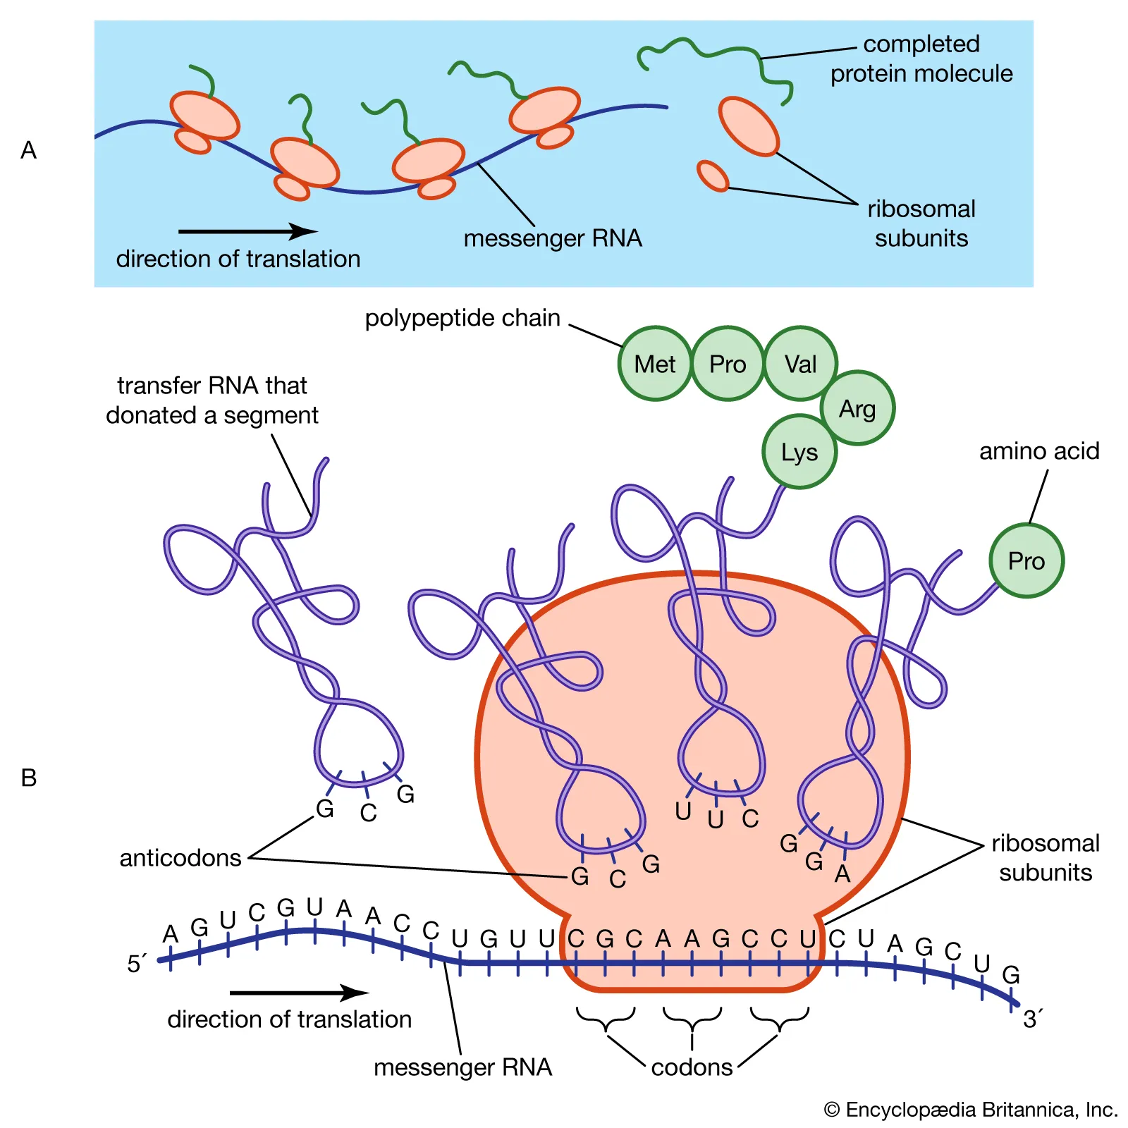
Example for transcription and translation
DNA and RNA
5’ to 3’
Protein
NH3 to COOH
ALWAYS peptide synthesis start from 5’ of RNA and starts at AUG codon
DNA 5’- A T T G C A T G C C G A C A T -3’
3’- U A A C G U A C G G C U G U A-5’ RNA
RNA synthesis direction
position of nucleotide in codon
3.2.1.
3’- U A A C G U A C G G C U G U A-5’ RNA
COOH - Asn – Cys – Ala - Ser - MET – NH3 peptide
Protein synthesis direction

Slide 52
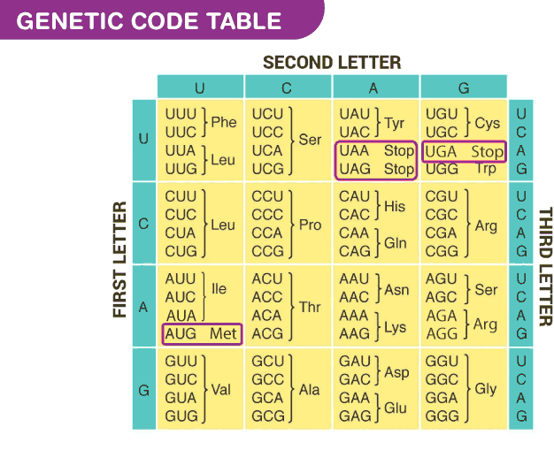
Example for transcription and translation
DNA and RNA
5’ to 3’
Protein
NH3 to COOH
ALWAYS peptide synthesis start from 5’ of RNA and starts at AUG codon
DNA 5’- A T T G C A T G C C G A C A T -3’
3’- U A A C G U A C G G C U G U A-5’ RNA
RNA synthesis direction
position of nucleotide in codon
3.2.1.
3’- U A A C G U A C G G C U G U A-5’ RNA
COOH - Asn – Cys – Ala - Ser - MET – NH3 peptide
Protein synthesis direction

Slide 53

From DNA to protein (transcription and translation)

Slide 54


Slide 55

How do we have different cell types?
Every cell in the human body shares a common starting point: a fertilized egg. As a result, all of our cells theoretically contain the same DNA.
Although all cells have the same genetic information, each cell type in our body has a different set of active genes.
These different patterns of gene expression cause our various cell types to have different sets of proteins, making each cell type uniquely specialized to do its job.

Slide 56

Gene expression pattern in different cell types
For example, one of the jobs of the liver is to remove toxic substances like alcohol from the bloodstream. To do this, liver cells express genes encoding an enzyme called alcohol dehydrogenase. This enzyme breaks alcohol down into a non-toxic molecule.
The neurons in a person’s brain don’t remove toxins from the body, so they keep these genes unexpressed, or “turned off.” Similarly, the cells of the liver don’t send signals using neurotransmitters, so they keep neurotransmitter genes turned off
However, different cells do some common activities (energy production, protein synthesis etc.) which means some genes are expressed in every cells.

Slide 57

How do we regulate gene expression?
Simply, there is regulation
at transcription level (when and how often a gene will be transcribed)
at translation level (which mRNA will be translated and how much will be translated)
on protein activity (when and where a protein will be active)

Slide 58


Slide 59
Proteins
Proteins are an essential human nutrient, obtained from both plant and animal foods.
Proteins can serve, e.g.,
as structural material (as in connective tissue and hair; see collagen; keratin),
as enzymes and hormones,
as transporters of essential substances such as oxygen (see hemoglobin)
as antibodies,
as regulators of gene expression.
Enzymes need vitamins (coenzyme) or metal atoms (cofactor) for proper function
Hemoglobin (need Fe++ (iron)), DNA polymerase (needs Mg++),
Proteins may be covalently linked to molecules, as to sugars (glycoproteins), phosphate groups (phosphoproteins), or sulfur (sulfoproteins).
Proteins are not stored for later use in animals. When an animal consumes excess proteins, they are converted into fats (glucose or triglycerides) and used to supply energy or build energy reserves. If an animal is not consuming sufficient protein, the body begins to break down protein-rich tissues, such as muscles, leading to muscle wasting and eventually death if the deficiency is severe.

Slide 60

Amino acids
Amino acids are classified as either essential or non-essential.
Although there are twenty amino acids required for human protein synthesis, humans can only synthesize about half of these required building blocks.
Essential amino acids, also known as indispensable amino acids, are amino acids that humans and other vertebrates cannot synthesize from metabolic intermediates. These amino acids must be supplied from an exogenous diet because the human body lacks the metabolic pathways required to synthesize these amino acids
The non-essential, also known as dispensable amino acids, can be excluded from a diet. The human body can synthesize these amino acids using only the essential amino acids. However, amino acids like arginine and histidine may be considered conditionally essential because the body cannot synthesize them in sufficient quantities during certain physiological periods of growth, including pregnancy, adolescent growth, or recovery from trauma

Slide 61


Other function of amino acids
Several α-amino acids (or their derivatives) act as chemical messengers. For example,
γ-aminobutyric acid (gamma-aminobutyric acid, or GABA; a derivative of glutamic acid),
serotonin and melatonin (derivatives of tryptophan),
histamine (synthesized from histidine) are neurotransmitters.
Thyroxine (a tyrosine derivative produced in the thyroid gland of animals) and indole acetic acid (a tryptophan derivative found in plants) are two examples of hormones.

Slide 62

Protein’s
3D
folding
A protein’s 3D (folding) shape is determined by the interaction between amino acids.

Slide 63


Wild-type vs Mutant
STK11 protein
Mutation causes amino acid difference in the protein.
The interaction between amino acids are affected.
Protein’s 3D shape changes
MCE1A protein
Wild-type (normal) mutant type

Slide 64
Sequence Change vs Mutation Type
Why/How do mutations cause disease?
polymorphism
1 4 7 10 13 16 19
ATG GGA GCC CTA TTA ACC TAA
met gly ala leu leu thr stop
ATG GGA GCT CTA TTT ACC TAA
met gly ala leu phe thr stop
ATG GGA GCC CTA TGA ACC TAA
met gly ala leu stop
ATG GGA GCT CTA TTA CAC CTA A
met gly ala leu leu his leu
Missense Mutation
Nonsense Mutation
Frameshift mutation!!!
(insertion/deletion)

Slide 65



Slide 66

The Shape of a Protein Is Specified by Its Amino Acid Sequence
Figure 4-1 Essential Cell Biology (© Garland Science 2010)

Slide 67

The Shape of a Protein Is Specified by Its Amino Acid Sequence
Side chain gives unique properties
Figure 4-2 Essential Cell Biology (© Garland Science 2010)

Slide 68

The Shape of a Protein Is Specified by Its Amino Acid Sequence
Figure 4-3 Essential Cell Biology (© Garland Science 2010)

Slide 69

The Shape of a Protein Is Specified by Its Amino Acid Sequence
noncovalent bonds shape the polypeptide chain
(Peptide bond is covalent bond)
Noncovalent bonds:
Electrostatic attractions
Hydrogen bond
Van der Waals atractions
Figure 4-4 Essential Cell Biology (© Garland Science 2010)

Slide 70


The Shape of a Protein Is Specified by Its Amino Acid Sequence
Hydrohpobic – hydrophilic interactions
Nonpolar - Hydrophobic aa – (phe, leu, val, trp) tend to cluster inside in folded protein
(hydrophobic oil droplets coalesce to form larger one)
Polar-Hydrophilic aa – (arg, glu, his) tend to arrange near outside of protein
to form H bond with water or other polar molecules
Figure 4-5 Essential Cell Biology (© Garland Science 2010)

Slide 71


Proteins Fold into a Conformation of Lowest Energy
Protein shape is formed to minimize free energy (G)
(by spontaneous or molecular chaperons in cytoplasm)
if a protein denatured to destroy folding, it will regain its shape again
Each protein is folded into one stable conformation
Sometimes the shape of proteins changes by modification or interaction
Modification: methylation, acetylation, phosphorylation of histones
Figure 4-7 Essential Cell Biology (© Garland Science 2010)

Slide 72

Proteins Fold into a Conformation of Lowest Energy
The proper structure of protein is important for its function and solubility
improper folded protein aggregate in cell, destroy cell (Alzheimer’s disease)
Mis-folded Prion protein aggregates:
mad cow disease
Misfolded prion can convert the properly folded prion into misfolded
Figure 4-8 Essential Cell Biology (© Garland Science 2010)

